Slide 1
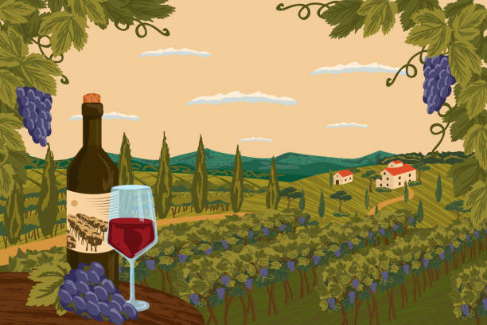
Bacchus wine case study
The Best Group
Joel Atkinson, Zac Baker, Kyle Klausen, Juan Macias Vasquez
Bellevue University
CSD310-H2323 Database Development & Use (2255-DD)
July 16, 2025

Slide 2



Introduction
We are a committed team of four software development students from Bellevue University, brought together by our shared interest in improving our skillsets in not only database design, but software development as a whole. For our course case study, we’ve worked remotely from different regions of the country, combining our unique backgrounds and view points in order to come together as a team, and build off each others’ abilities. Our team includes Joel, Zac, Juan, and Kyle. We each add our own strengths and feedback to the milestones, which has allowed us to collectively design and create a fantastic solution to the updated database needs presented to us in the ”Bacchus Winery” case study that we are all proud of, and excited to present.
Software Development

Slide 3
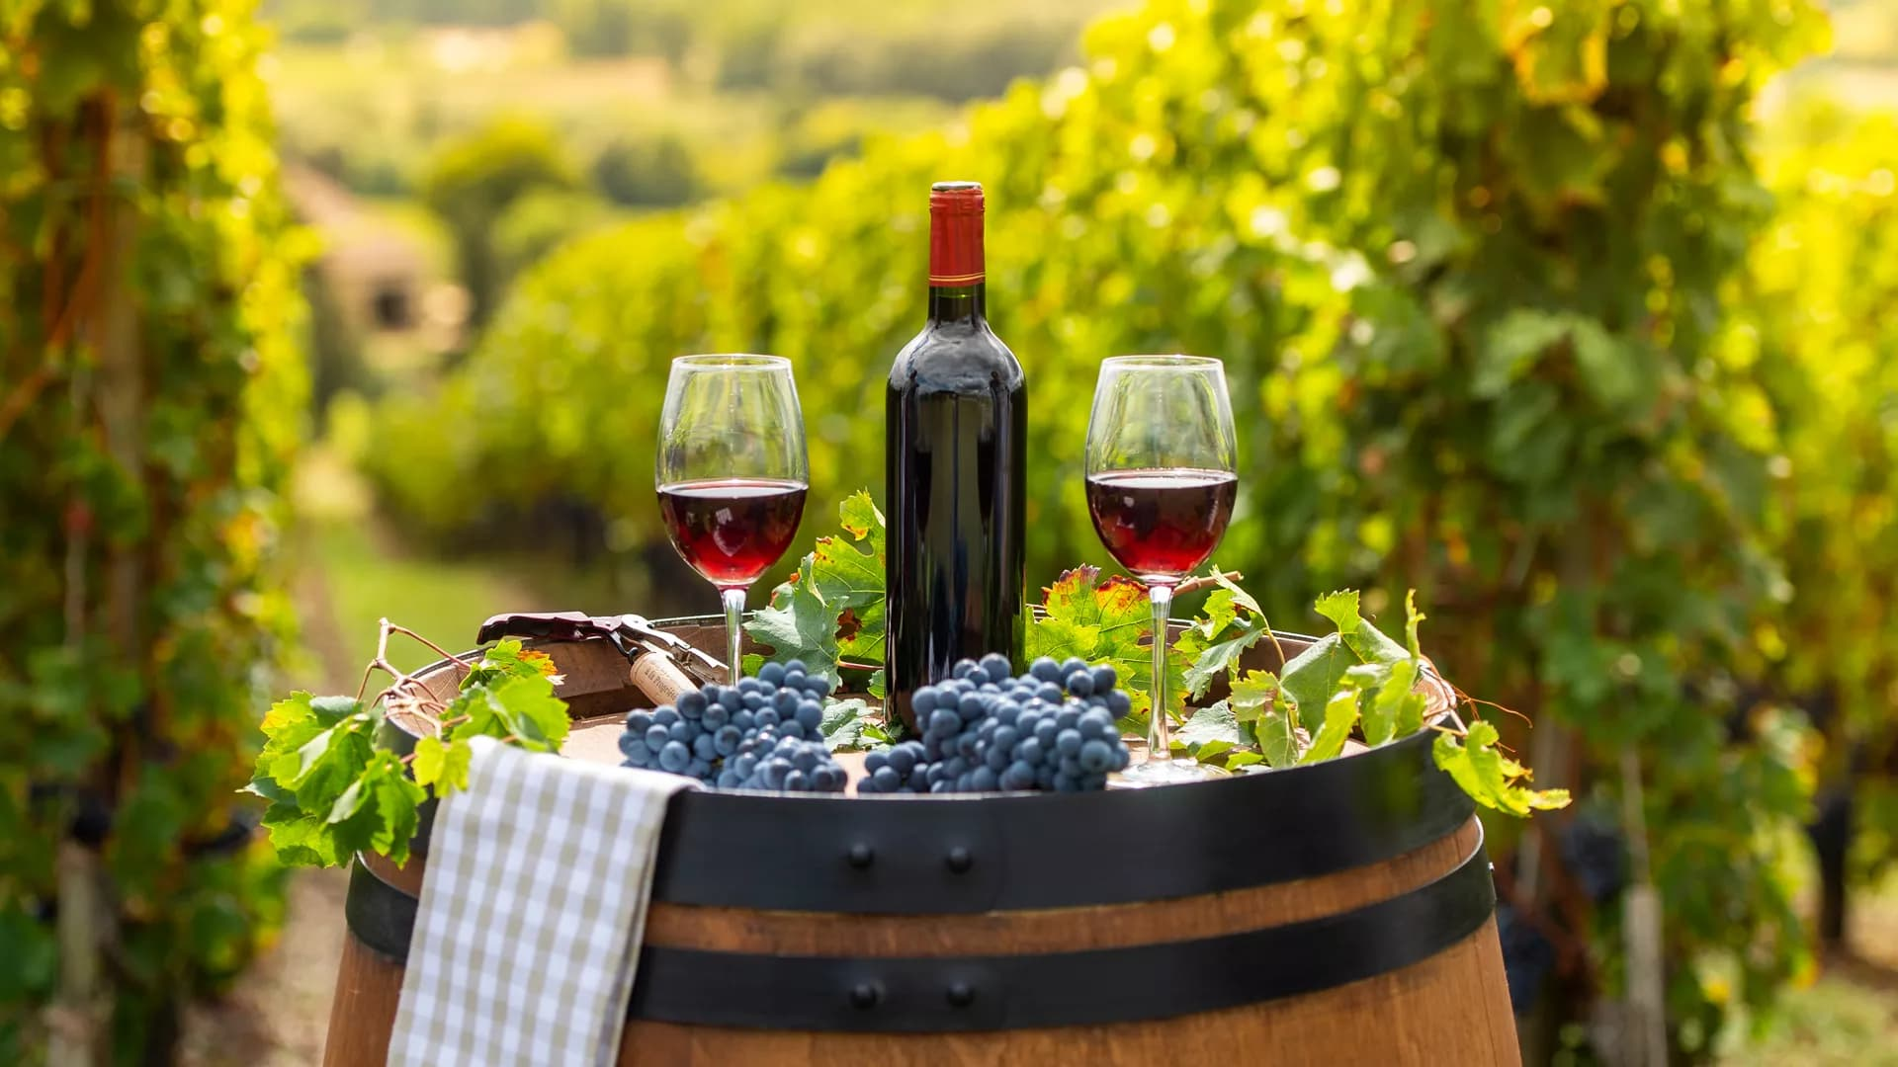
Case Study
Bacchus Winery, a family-owned business inherited by brothers Stan and Davis Bacchus three years ago from their father, George, is looking to modernize its operations. The winery, which produces Merlot, Cabernet,Chablis, and Chardonnay, currently relies on a team including Janet Collins (finances and payroll), Roz Murphyand her assistant Bob Ulrich (marketing), Henry Doyle (production with 20 employees), and Maria Costanza(distribution). They seek efficient methods to track and order supplies which include bottles and corks from one supplier, labels and boxes from another, and vats and tubing from a third. Maria also wants distributors to order online and track shipments. With the yearly business snapshot due soon, Stan and Davis need updated data to provide more accurate insights to a number of topics. Are suppliers delivering on time with any significant gaps between expected and actual delivery? How are wines selling, and which distributor carries which wine? (With emphasis on those wines not performing well). Additionally, they require data on employee hours worked over the last four quarters. For each of these topics, the goal is to output monthly reports in order to accurately update Stan and Davis with accurate data regarding their business's performance. To address these needs, our team has created a list of business rules and assumptions for the updated database, have created a detailed ERD that mapped out the database tables and required connections to display how the database will work together and pull the necessary data, coded the database tables into a new MySQL database and imported that database to a Python program that pulls and displays the data as well as the required monthly reports.

Slide 4
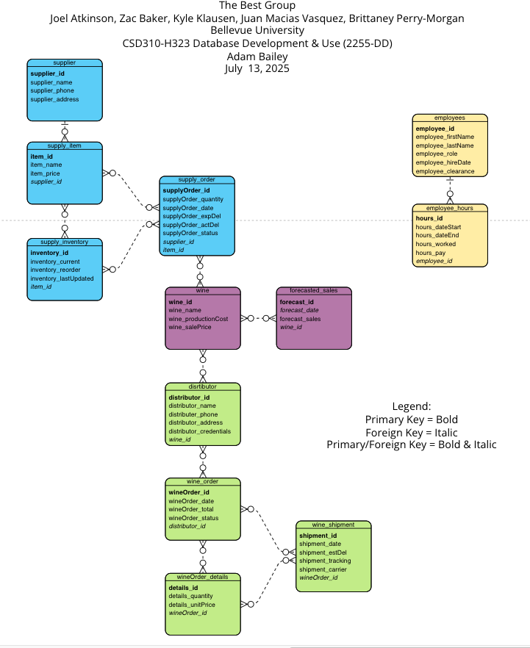
Our ERD
Our ERD provided is a visual representation of the database design for Bacchus Winery, outlining the relationships between key entities involved in the winery's operations. It maps out tables such as supplier, supply_item, supply_inventory,supply_order, wine, forecasted_sales,distributor, wine_order, wineOrder_details, wine_shipment, employees, and employee_hours,each with clearly defined primary keys (in bold) and foreign keys (in italics or bold italics for primary/foreign keys). This structure connects suppliers to inventory and orders, links wines to distributors and sales forecasts, and tracks employee hours, effectively addressing the case study’s needs for monitoring supplier deliveries, wine distribution, and employee time across the last four quarters.

Slide 5
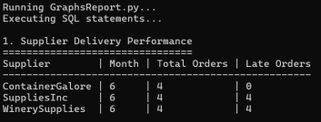
Supplier delivery reports
This report tracks how often suppliers deliver on time and calculates the average delay in days when they’re late. We used the expected and actual delivery dates from each supply order to figure out how reliable each supplier is. The data is broken down by month and by supplier, so it’s easier to spot patterns—like whether certain suppliers tend to be late or if delays happen more often in specific months. This kind of report helps flag problem areas early so they can be addressed before they become bigger issues.

Slide 6
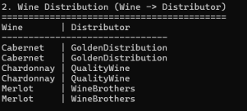
Wine distribution
This report shows which distributor is handling which wines. It helps organize and visualize distribution channels, showing whether a wine is being distributed by one company or multiple. In this case, GoldenDistribution handles all Cabernet, QualityWine handles all Chardonnay, and WineBrothers is responsible for Merlot. This setup gives a clearer picture of distributor responsibility.

Slide 7
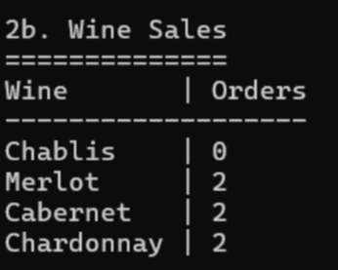
Wine sales
Shows how many individual orders have included each type of wine. Rather than focusing on quantity sold, this report counts how many times each wine appeared in orders. It’s a quick way to gauge popularity across recent sales. Chablis, for example, has no recent orders, while the other three wines have each been ordered twice.

Slide 8
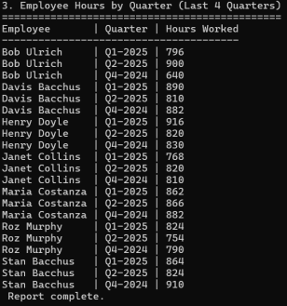
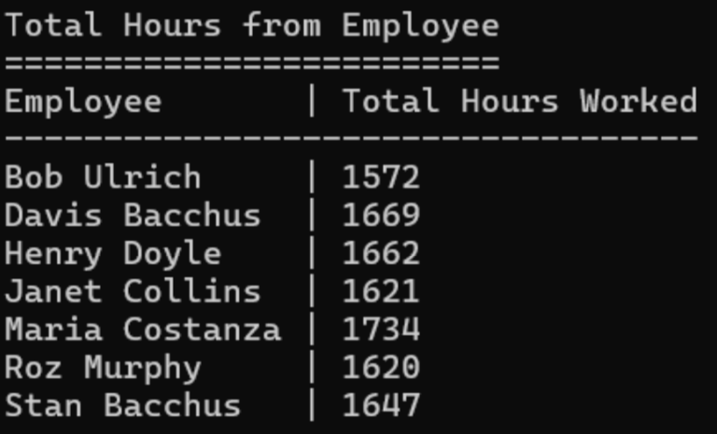
Employee hours by quarter & Employee hours total
Quarter Report - This report shows how many hours each employee worked in each quarter, going back four quarters. It provides a full breakdown per employee, grouped by quarter, which is especially useful for tracking labor effort over time. For example, Maria Costanza consistently worked over 860 hours per quarter, while other employees had more variation. This satisfies the requirement to show quarterly labor performance and supports payroll and staffing analysis.
Total report - This report adds up how many hours each employee worked across all four quarters. It’s helpful for getting a quick summary of the overall workload per person. While the quarterly report gives a breakdown over time, this one shows who’s been putting in the most time overall. It’s a good way to identify top contributors or spot imbalances in workload. For instance, our employee, Maria Costanza, clearly logs a lot of hours compared to others.

Slide 9
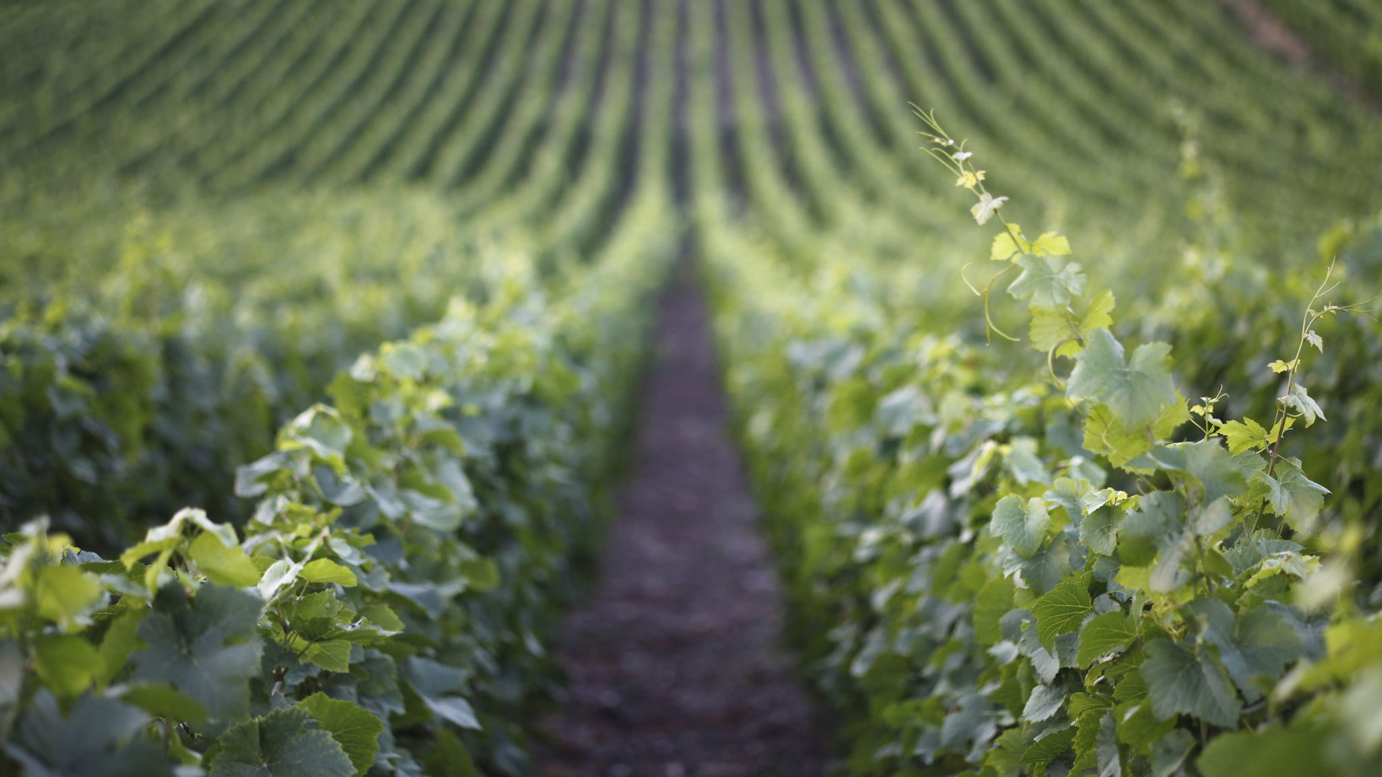
Assumptions
We made a few assumptions while working on this assignment to help guide our decisions. Since not all the details were provided in the case study, we had to fill in some of the gaps with what we believed made the most sense.
We assumed that the winery already has some basic systems in place for things like tracking inventory, employees, and orders. The database we created wasn’t meant to replace everything they use—it was more about improving the process and helping organize things like deliveries, sales, and hours worked.
We also tried to imagine how the winery might actually operate day to day—from getting supplies in, managing wine production, and sending out products through different distributors. Some of that wasn’t explained directly, so we had to use our best judgment based on what made sense for a business like this.
One example is employee tracking. As Juan mentioned, we just used regular hours worked instead of getting into shift details or advanced scheduling. There wasn’t enough info to go deeper, and we didn’t want to assume too much.
Other specific assumptions we made:
There’s already a basic database or system handling some of the core operations—we’re just building on top of that.
The main areas that need improvement are delivery tracking, sales reporting, and employee hour tracking.
We focused on comparing expected vs. actual results (like deliveries and hours) because that seemed to be the priority.
Wine distribution is organized so that each distributor handles certain wines—this helps simplify reporting and planning.
Since full data wasn’t given, we created example records to show how the system could work in a real situation.
These assumptions helped us stay focused on what mattered most and build a system that works—even if some of the pieces had to be imagined based on experience and common sense.

Slide 10
Final Thoughts & Key Takeaways
This case study gave our team a better understanding of how real-world challenges are handled through thoughtful planning and teamwork. As we worked on our project, we saw clear connections between the case and our own process—especially in how important communication and adaptability are. When we hit roadblocks, we looked back at the case to guide our decisions and keep us aligned. The biggest takeaway for us is that successful outcomes depend on collaboration, flexibility, and learning from real examples. This experience helped us grow and gave us a better grasp of what teamwork looks like in practice.

